Slide 1
JAVA PROGRAMMING
APPLETS and GUI -Graphical User Interface
Module 5

Slide 2
Contents
Applet Overview, Applet Default Methods, GUI
Swing Components
Jlabel, JTextField, Jbutton
JRadioButton
JCheckBox
Jpanels
Layout Managers
FlowLayout, GridLayout, BorderLayout
Direct Positioning
Case Studies

Slide 3
APPLET
An applet is a program written in the Java programming language that can be included in an HTML page, much in the same way an image is included in a page.
An applet is a Java program designed to be executed via a Java-enabled web browser
When you use a Java technology enabled browser to view a page that contains an applet, the applet's code is transferred to your system and executed by the browser's Java Virtual Machine (JVM)
Applet programs can be viewed from web browsers such Internet Explorer and Netscape

Slide 4
How To Develop an Applet
You must have TWO files: java file and html file to order develop an Applet
Java file (*.java) is used to write source Code
HTML file (*.html) is used to embed applet in order to be viewed from Internet browsers

Slide 5
How to Develop Applet
EXAMPLE OF JAVA FILE FOR APPLET (example.java):
public class example extends JApplet {
// insert code here
} //class
All Applets should extends JApplet
Default Methods such as paint(), init(), start(), destroy() and stop()

Slide 6
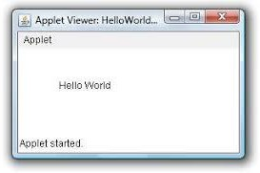
How to Develop Applet
EXAMPLE OF HTML file (example.html):
<html>
<applet code=“example.class” width=200 height=200>
</applet>
</html>
To run an applet we require one of the following tools :
java enabled web browser
(such as HotJava or Netscape)
Java appletviewer (Command prompt)

Slide 7
Code for demo.java
import java.applet.*; import java.awt.*;
public class newClass extends Applet
{
public void paint (Graphics g)
{
g.drawString("Hello World", 300, 150);
}
}
Html code : saved as demo.html
<!DOCTYPE html>
<html>
<head>
<title>HTML applet Tag</title>
</head>
<body>
<applet code = "demo.class" width = "300" height = "200"></applet>
</body>
</html>

Slide 8
Passing parameters to Applet
Param tag has two attributes :
Name
Value
Steps to accomplish this task -:
To pass the parameters to the Applet we need to use the param attribute of <applet> tag.
To retrieve a parameter's value, we need to use the getParameter() method of Applet class.

Slide 9
Java program saved as : UseParam.java
import java.applet.Applet; java.awt.Graphics;
public class UseParam extends Applet
{
public void paint(Graphics g)
{
String str=getParameter("msg");
g.drawString(str,50, 50);
}
}
Html document saved as : Myapplet.html
<html>
<body>
<applet code="UseParam.class" width="300" height="300">
<param name="msg" value="Welcome to applet">
</applet>
</body>
Welcome to applet
</html>

Slide 10
Default Methods in class JApplet
There are FIVE(5) default methods in applets as listed below:
init ()
start ()
destroy ()
paint ()
stop ()
It is NOT compulsory to have all these methods in an Applet

Slide 11
Default Methods in class JApplet
public void init()
This method acts as a constructor Invoked automatically by the system when Applet is launched in a browser
public void start()
The start() method is called at least once in an applet's life, when the applet is started or restarted.
In some cases it may be called more than once. Many applets you write will not have explicit start() methods and will merely inherit one from their super class.
A start() method is often used to start any threads the applet will need while it runs.

Slide 12
Default Methods in class JApplet
public void stop()
The stop() method is called at least once in an applet's life, when the browser leaves the page in which the applet is embedded.
The applet's start() method will be called if at some later point the browser returns to the page containing the applet.
In some cases the stop() method may be called multiple times in an applet's life.
Many applets you write will not have explicit stop() methods and will merely inherit one from their superclass.

Slide 13
Default Methods in class JApplet
public void destroy
The destroy() method is called exactly once in an applet's life, just before the browser unloads the applet.
This method is generally used to perform any final clean-up.
public void paint()
This method is used for drawing using command g.drawString, g.drawString(), etc

Slide 14
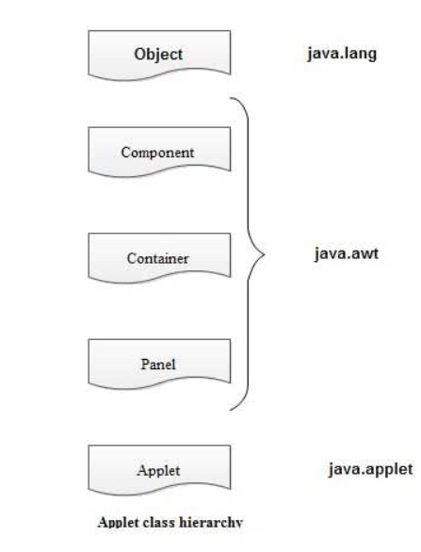
Class Hierarchy for Applets
When we start writing any applet program we essentially import two packages namely – java.awt and java.applet.
The java.applet package contains a class Applet which uses various interfaces such as AppletContext.
The applet class is an extension of Panel class belonging to java.awt package.
There is a Component class from java.awt package which derives several classes for components.
These classed include Check box, Choice, List, buttons and so on. The Component class in java.awt is an abstract class.

Slide 15
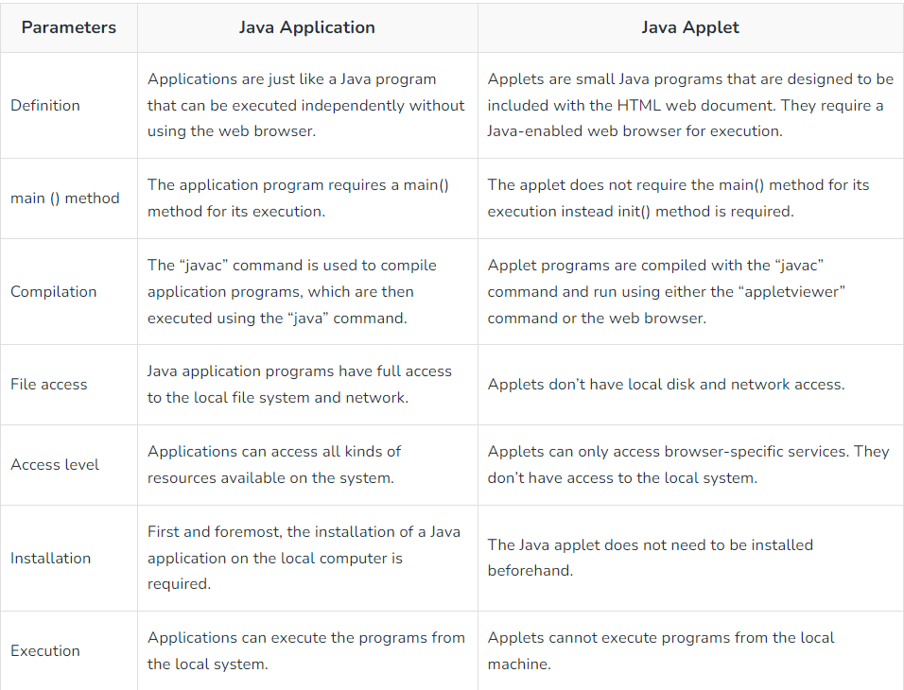
Differences between applets and applications

Slide 16
How to Passing Parameters to Applets
Java allows users to pass user-defined parameters to an applet with the help of <PARAM>tags. The <PARAM>tag has a NAME attribute which defines the name of the parameter and a VALUE attribute which specifies the value of the parameter. In the applet source code, the applet can refer to the parameter by its NAME to find its value. The syntax of the <PARAM>tag is:
<APPLET>
<PARAMNAME=parameter1_name VALUE=parameter1_value>
<APPLET>
<PARAMNAME=text VALUE=This is an example of Parameter!!!>
</APPLET>

Slide 17
Lifecycle of applets
All these are available in AWT package java.awt.applet.* and in order ton import paint (Graphics g) we do use java.awt.component package
Method 1: init()
This is the first method to be called
Variables can be initialized here
This method can be called only once during the run time of the applet
It is invoked at the time of Initialization
Syntax:
public void init() { // To initialize objects }

Slide 18
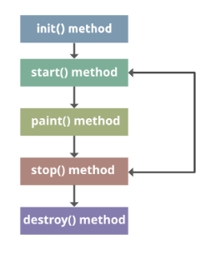
Method 2: start()
This method is called after init() method
start() method is used for starting the applet
It is also called to restart an applet after it has been stopped.
Syntax:
public void start() { // To start the applet code }
Method 3: paint()
void paint(Graphics g){ }paint() method is used for painting any shapes like square, rectangle, trapeziums, etc.
paint() method has one parameter of type Graphics Class, this Graphics class enables the painting features in an applet.
This parameter will contain the graphics context, which is used whenever output for the applet is required.
Syntax:
public void paint(Graphics graphics) { // Any shape's code }

Slide 19
Direct Positioning
You can place a component at a specific <x,y> position
Method
- choose not to use a Layout Manager setLayout( null );
- position components with the method setLocation and setSize.
setLocation(int x, int y);
setSize(int width, int height);
OR
setBounds(int x, int y, int width, int height);

Slide 20
import javax.swing.*;
import java.awt.*;
public class Nolayout extends JApplet {
private JButton button1;
public void init( ) {
Container con = getContentPane( );
button1 = new JButton("Channel 1");
button1.setLocation(20,40);
button1.setSize(60,15);
//button1.setBounds(70,200,70,20);
con.add(button1);
con.add(channelLabel);
}
}

Slide 21
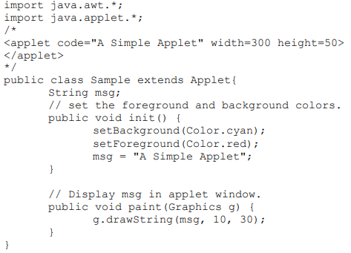
Write a. Java Applet that sets the background color to cyan and foreground color to red and outputs a string message "A simple Applet”

Slide 22
Graphical User Interface (GUI)
GUI enables interactivity with the user using graphical components such as button, textfield, etc
Graphical User Interface (GUI)
Gives program distinctive “look” and “feel”
Provides users with basic level of familiarity
Built from GUI components (controls, widgets, etc.)
User interacts with GUI component via mouse, keyboard, etc.

Slide 23
Graphical User Interface
THREE (3) elements that we need to have in developing an Applet is the following:
CONTAINER
COMPONENTS
LAYOUT MANAGER

Slide 24
Graphical User Interface
Components: Graphical components (such as button, label, etc) that enables interactivity between user and computer/machine.
Components should be created in method init() of an applet
Container: A space where we put all the components above
Example: Container container = getContentPane();
All Applet programs that has GUI must have container to hold the components
Command add is used to place components in a container
Layout Manager: To determine how we are going arrange the components in the container

Slide 25
Some basic GUI components
Component Description
JLabel An area where uneditable text or icons can be displayed.
JTextField An area in which the user inputs data from the keyboard. The area can also display information.
JButton An area that triggers an event when clicked.
JCheckBox A GUI component that is either selected or not selected.
JComboBox A drop-down list of items from which the user can make a selection by clicking an item in the list or possibly by typing into the box.
JList An area where a list of items is displayed from which the user can make a selection by clicking once on any element in the list.
Double-clicking an element in the list generates an action event.
Multiple elements can be selected.
JPanel A container in which components can be placed.

Slide 26
Swing Overview
Swing GUI components
Package javax.swing
Components originate from AWT (package java.awt)
Contain look and feel Appearance and how users interact with program Lightweight components Written completely in Java

Slide 27
Swing Overview
Available in the javax.swing package
Jbutton
Jlabel
Jmenu
JMenuItem
JTextField
Jtable
JSlider - Simulates a slider control
JProgressBar – Displays the progress of a time consuming operation

Slide 28
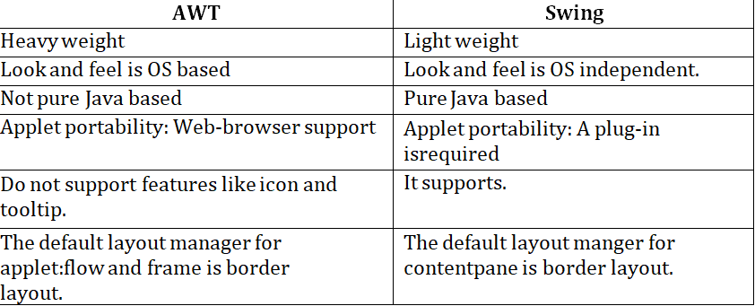

Slide 29
Component: JLabel
Label
Provide text on GUI
Defined with class Jlabel
Can display single line
Example:
JLabel nameLabel1 = new JLabel("Student name");
//Creates label with the label Student Name
JLabel nameLabel2 = new JLabel();
//Creates an empty label

Slide 30
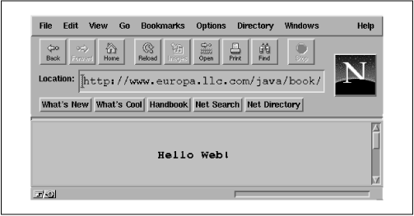
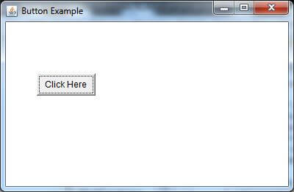
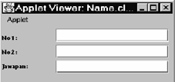
Keypoints
Import the requires packages
Extend the Applet class
Create instance of controllers
Create an objects of those instance controllers assign value to it
Placing the controller on applets
If we have single controller, It will be placed with in containers

Slide 31
Key points cont..
If we have 3 labels and 3 textbox to be placed, Here we need to place row and column wise, so we can use Layout
Firstly, we need to create container,
Secondly, within container place the layouts, and then we can place the labels and textbox in row and column wise.
If we have to display category wise details:
Firstly, we need to create container
Secondly, we need to add category wise panels
Thirdly, for every panel we need to add layouts
Finally, for every panel with in those layout we can place the controllers accordingly

Slide 32
// Demonstrating the JLabel class. // Java core packages
import java.awt.*;
// Java extension packages
import javax.swing.*;
public class LabelTest extends JApplet {
private JLabel label1, label2;
// set up GUI
public void init()
{
// get content pane and set its layout

Slide 33
Example of Jlabel class
Container container = getContentPane();
// JLabel constructor with a string argument
label1 = new JLabel();
// JLabel constructor with a string argument
label2 = new JLabel( "Label with text" );
container.add( label1 );
container.add( label2 );
} //init
}//class

Slide 34
Component: JTextField
JTextField
Single line area in which user can enter text
Example:
JTextField txt1 = new JTextField(“First Name");
//Creates textfield with that displays the message First Name
JTextField txt2 = new JTextField();
//Creates an empty textfield
JTextField txt3 = new JTextField(10);
//Creates textfield with 10 columns

Slide 35
Component: JTextField
import java.awt.*; Outline
import java.awt.event.*;
import javax.swing.*;
public class TextFieldTest extends JApplet {
private JTextField textField1, textField2;
public void init()
{

Slide 36
Component: JTextField
Container container = getContentPane();
// construct textfield with default sizing
textField1 = new JTextField( 10 );
// construct textfield with default text
textField2 = new JTextField( "Enter text here" );
container.add( textField1 );
container.add( textField2 );
}
}

Slide 37
Component: JButton
Button
Component user clicks to trigger a specific actionComponent: Jbutton
Example:
JButton button1 = new JButton(“RESET");
//Creates button with that displays the message
RESET
JButton button2 = new JButton();
//Creates an empty button

Slide 38
Component: JButton
import java.awt.*;
import java.awt.event.*;
import javax.swing.*;
public class ButtonTest extends JApplet {
private JButton plainButton, fancyButton;
// set up GUI
public void init()
{
// get content pane and set its layout

Slide 39
Component: JButton
Container container = getContentPane();
// create buttons
plainButton = new JButton( "Plain Button" );
fancyButton = new JButton( );
container.add( plainButton );
container.add( fancyButton );
}
}

Slide 40
Component: JCheckBox and JRadioButton
State buttons
On/Off or true/false values
Some of these tools in Java are:
JCheckBox
JRadioButton

Slide 41
// Java core packages
import java.awt.*;
import java.awt.event.*;
// Java extension packages
import javax.swing.*;
public class CheckBoxTest extends JApplet {
private JCheckBox bold, italic;
// set up GUI
public void init ()
{
// get content pane and set its layout

Slide 42
Java Core Packages
Container container = getContentPane();
// create checkbox objects
bold = new JCheckBox( "Bold" );
italic = new JCheckBox( "Italic" );
container.add( bold );
container.add( italic );
}
}

Slide 43
Program example of how to develop applet using JRadioButton is shown in the next slide:
import java.awt.*;
import java.awt.event.*;
// Java extension packages
import javax.swing.*;
public class RadioButtonTest extends JApplet {
private JRadioButton plainButton, boldButton, italicButton, boldItalicButton;
private ButtonGroup radioGroup;
// create GUI and fonts
public void init()

Slide 44
Program example of how to develop applet using JRadioButton is shown in the next slide:
{
// get content pane and set its layout
Container container = getContentPane();
plainButton = new JRadioButton( "Plain", true );
container.add( plainButton );
boldButton = new JRadioButton( "Bold", false);
container.add( boldButton );
italicButton = new JRadioButton( "Italic", false );
container.add( italicButton );
boldItalicButton = new JRadioButton( "Bold/Italic", false );

Slide 45
Program example of how to develop applet using JRadioButton is shown in the next slide:
container.add( boldItalicButton );
// create logical relationship between JRadioButtons
radioGroup = new ButtonGroup();
radioGroup.add( plainButton );
radioGroup.add( boldButton );
radioGroup.add( italicButton );
radioGroup.add( boldItalicButton );
}
}

Slide 46
Layout Managers
Other swing components are Jcombobox, JTextArea, etc
Layout managers
Provided for arranging GUI components
Provide basic layout capabilities
Processes layout details
Programmer can concentrate on basic “look and feel”

Slide 47
Layout Managers
Layout manager Description
FlowLayout Default for java.awt.Applet, java.awt.Panel and javax.swing.JPanel. Places components sequentially (left to right) in the order they were added. It is also possible to specify the order of the components using the Container method add that takes a Component and an integer index position as arguments.
BorderLayout Default for the content panes of JFrames (and other windows) and JApplets. Arranges the components into five areas: North, South, East, West and Center.
GridLayout Arranges the components into rows and columns.

Slide 48
Layout Manager: FlowLayout
FlowLayout
Most basic layout manager : GUI components placed in container from left to right. We can centralised the components that using FlowLayout manager using the following command:
new FlowLayout(FlowLayout.CENTER);
OR
new FlowLayout();
NOTE: FlowLayout is the default layout if an applet has not been given any layout setting by the programmer

Slide 49
Layout Manager: FlowLayout
We can left-justify the components that using
FlowLayout manager using the following command: new FlowLayout(FlowLayout.LEFT);
We can right-justify the components that using FlowLayout manager using the following command: new FlowLayout(FlowLayout.RIGHT);

Slide 50
Flow Layout
import javax.swing.*;
import java.awt.*;
public class Channels extends JApplet{
private Button channel1, channel2, channel3, channel4;
public void init( )
{
Container con = getContentPane( );
con.setLayout( new FlowLayout( ) );

Slide 51
Flow Layout
channel1 = new JButton(“Channel 1”);
channel2 = new JButton(“Channel 2”);
channel3 = new JButton(“Channel 3“);
channel4 = new JButton(“Channel 4”);
con.add(channel1);
con.add(channel2);
con.add(channel3);
con.add(channel4);
}
}

Slide 52
//The program below showing how to use FlowLayout (Right Justified)
import javax.swing.*;
import java.awt.*;
public class Channels extends JApplet{
private Button channel1, channel2, channel3, channel4;
public void init( )
{
Container con = getContentPane( );
con.setLayout( new FlowLayout(FlowLayout.RIGHT));

Slide 53
//The program below showing how to use FlowLayout (Right Justified)
channel1 = new JButton(“Channel 1”);
channel2 = new JButton(“Channel 2”);
channel3 = new JButton(“Channel 3“);
channel4 = new JButton(“Channel 4”);
con.add(channel1);
con.add(channel2);
con.add(channel3);
con.add(channel4);
}
}

Slide 54
Layout Manager: BorderLayout
BorderLayout
Arranges components into five regions
NORTH (top of container)
SOUTH (bottom of container)
EAST (left of container)
WEST (right of container)
CENTER (center of container)

Slide 55
BorderLayout
import javax.swing.*;
import java.awt.*;
public class Bordertest extends JApplet
{
private JButton button1, button2, button3, button4, button5;
public void init( )
{
Container con = getContentPane( );
con.setLayout( new BorderLayout( ) );
button1 = new JButton(“Channel 1”);

Slide 56
BorderLayout
button2 = new JButton(“Channel 2”);
button3 = new JButton(“Channel 3“);
button4 = new JButton(“Channel 4”);
button5 = new JButton(“Channel 5”);
con.add(“North”,button1);
con.add(“South”,button2);
con.add(“East”,button3);
con.add(“West”,button4);
con.add(“Center”,button5);
}
}

Slide 57
Layout Manager: GridLayout
GridLayout
Divides container into grid of specified row an Columns
Components are added starting at top-left cell
Proceed left-to-right until row is full

Slide 58
GridLayout
import javax.swing.*;
import java.awt.*;
public class Channelgrid extends JApplet {
private JButton channel1, channel2, channel3, channel4;
private JButton channel5, channel6, channel7, channel8;
public Channelgrid( )
{
Container con = getContentPane( );

Slide 59
GridLayout
con.setLayout( new GridLayout( 2,4) );
channel1 = new JButton(“Channel 1”);
channel2 = new JButton(“Channel 2”);
channel3 = new JButton(“Channel 3“);
channel4 = new JButton(“Channel 4”);
channel5 = new JButton(“Channel 5”);
channel6 = new JButton(“Channel 6”);
channel7 = new JButton(“Channel 7“);
channel8 = new JButton(“Channel 8”);

Slide 60
GridLayout
con.add(channel1);
con.add(channel2);
con.add(channel3);
con.add(channel4);
con.add(channel5);
con.add(channel6);
con.add(channel7);
con.add(channel8);
}
}

Slide 61
Assignment
Create 3 buttons.
Place one at position 20,40.
Place another at 70, 200.
Place the last one at 140,70.

Slide 62
Assignment
import javax.swing.*;
import java.awt.*;
public class Nolayout extends JFrame{
private JButton button1, button2, button3;
public void init( ) {
Container con = getContentPane( );
con.setLayout(null );
button1 = new JButton("Channel 1");
button2 = new JButton("Channel 2");
button3 = new JButton("Channel 3");

Slide 63
Assignment
button1.setLocation(20,40);
button1.setSize(60,15);
button2.setBounds(70,200,70,20);
button3.setBounds(140,70,80,80);
con.add(button1);
con.add(button2);
con.add(button3);
con.add(channelLabel);
}
}

Slide 64
Panels
Panel
Helps organize components
Class JPanel is JComponent subclass
May have components (and other panels) added to Them
Panels is useful when developing GUI that has more than one layout and many components
An applet can have more than one Jpanels
The rules is that the more panels in an applet, the easier to organize the components
Finally, panel should be added to main container

Slide 65
Panels
import java.awt.*;
import java.awt.event.*;
import javax.swing.*;
public class ButtonTest extends JApplet {
private JButton plainButton;
private JPanel panel1;
// set up GUI
public void init()
{
// get content pane and set its layout

Slide 66
Panels
Container container = getContentPane();
container.setLayout(new FlowLayout(FlowLayout.CENTER));
pane11= new JPanel();
panel1.new GridLayout(1,1);
// create buttons
plainButton = new JButton( "Plain Button" );
panel1.add(plainButton);
container.add(panel1 );
}
}

Slide 67
CASE STUDY 1
TASK: YOU NEED TO DEVELOP APPLET FOR THE
FOLLOWING GUI:

Slide 68

IN ORDER TO DEVELOP THE GUI, FOLLOW THE FOLLOWING STEPS:
STEP 1: IDENTIFY THE LAYOUT TO BE USED.
WE CAN USE GRIDLAYOUT SINCE THERE ARE 3 ROWS AND 2 COLUMNS

Slide 69

STEP 2: IDENTIFY ALL THE COMPONENTS

Slide 70
STEP 3: WRITE THE PROGRAM.
import java.awt.*;
import java.awt.event.*;
// Java extension packages
import javax.swing.*;
public class caseStudy1 extends JApplet {
private JTextField t1, t2, t3;
private JLabel label1, label22, label3;
// set up GUI
public void init()
{

Slide 71
STEP 3: WRITE THE PROGRAM.
// get content pane
Container con = getContentPane();
con.setLayout(new GridLayout(3,2));
label1= new JLabel(“No1:”);
label2= new JLabel(“No2:”);
label3= new JLabel(“Jawapan:”);
t1= new JTextField(10);
t2= new JTextField(10);
t3= new JTextField(10);

Slide 72
STEP 3: WRITE THE PROGRAM.
con.add(label1);
con.add(t1);
con.add(label2);
con.add(t2);
con.add(label3);
con.add(t3);
}
}

Slide 73
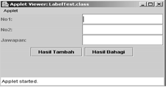
CASE STUDY 2
In CASE STUDY 1, the Applet has many different components using a layout manager. In some cases you need to use more than one layout managers. Otherwise you will find it difficult to arrange the components accordingly. Remember: If you use more than one layouts, then you must have many JPanels. Now let us develop applet for the GUI below:

Slide 74
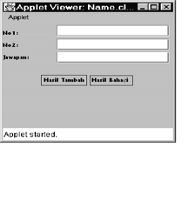
Use Divide and Conquer technique for GUI that has many layout managers:

Slide 75
Before you write the code, you need to identify layout to be used for container, panel1 and panel2.
You need to make sure that each panels can accommodate a separate layout managers:

Slide 76
The main container uses GridLayout(2,1) to accommodate panel1 and panel2 as shown in the next slide:

Slide 77
Code for case Study 2
import java.awt.*;
import java.awt.event.*;
// Java extension packages
import javax.swing.*;
public class caseStudy2 extends JApplet {
private JTextField t1, t2, t3;
private JLabel label1, label2, label3;
JButton b1,b2;
JPanel panel1, panel2;
// set up GUI

Slide 78
Code for case Study 2
public void init()
{
// get content pane
Container con = getContentPane();
con.setLayout(new GridLayout(2,1));
panel1 = new JPanel();
panel1.setLayout(new GridLayout(3,2));
panel2 = new JPanel();
panel2.setLayout(new

Slide 79
Code for case Study 2
FlowLayout(FlowLayout.CENTER));
label1= new JLabel(“No1:”);
label2= new JLabel(“No2:”);
label3= new JLabel(“Name:”);
t1= new JTextField(10);
t2= new JTextField(10);
t3= new JTextField(10);
b1= new JButton(“Cancel”);
b2= new JButton(“Okey”);
panel1.add(label1); Outline

Slide 80
Code for case Study 2
panel1.add(t1);
panel1.add(label2);
panel1.add(t2);
panel1.add(label3);
panel1.add(t3);
panel2.add(b1);
panel2.add(b2);
con.add(panel1);
con.add(panel2);
}
}

Slide 81
One more Applet example
import java.awt.*; import java.applet.Applet; public class ManyComp extends Applet { Button aButton; Canvas aCanvas; Checkbox aBox; Label aLabel; List aList; Scrollbar aScrollbar; TextField aTextField; TextArea aTextArea;

Slide 82
One more Applet example
public void init() { aButton = new Button(“Ok”); aCanvas = new Canvas(); aBox = new Checkbox(“Show”); aLabel = new Label(“Hello!”); aList = new List(); aScrollbar = new Scrollbar(Scrollbar.HORIZONTAL); aTextField = new TextField(“37”, 5); aTextArea = new TextArea(“Ok”, 5, 40); aList.addItem(“First”); aList.addItem(“Second”);

Slide 83
One more Applet example
add(aButton); add(aCanvas); add(aBox); add(aLabel); add(aList); add(aScrollbar); add(aTextField); add(aTextArea); } }

Slide 84
One more Applet example
<applet code=ManyComp.class width=250 height=600></applet>

